Slide 1
Byte-by-Byte
A Natural Language Assistant for all your homeworks
-Deep Pandya
-Meet Mukadam
-Mandhara Jayaram

Slide 2
Introduction
A tool to divide homework into categories and track the progress.
Also designed to adapt to the coursework provided smartly.
Uses Natural Language Processing to analyze the course material.

Slide 3
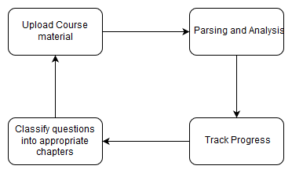
Workflow

Slide 4
Natural Language Processing
Text preprocessing - Eliminating stop words, punctuations
Bag of Words with NGram and Term Document Frequencies.
Calculate frequency and probability for each non stop word encountered.
Create a dictionary to store the model.

Slide 5
Deploying API
Flask service to deploy an API that accepts text documents and trains or classifies the questions respectively.
Used Google Cloud Platform to host the service

Slide 6
FrontEnd
UI made using JavaScript
Can upload the assignment as well as the notes.
Visual analysis of the data.

Slide 7
https://localhost:8082/BytebyByte

